Slide 1
Reinforcement Algorithm
Q-Learning
n.h.reyes@massey.ac.nz

Slide 2
What is Reinforcement Learning?

Slide 3


K-armed bandit problem
Casino with k-slot machines, the agent is given 1000 tries to maximise its winnings.
What would an agent do you, if it does not know how the world works?
Each slot machine has a hidden probability of paying off.
Whenever an arm is pulled, the outcome is independent of previous
outcomes and is determined by the hidden payoff probability.
Notes:
You have 1,000 tries to make as much money as you possibly can in a casino with k-slot machines. What would be a good strategy?

Slide 4

Bandit strategies
Switch on a loser – pick one lever, for as long as it keeps on paying off, keep pulling it. As soon as it loses, switch to another slot machine. (better than pure random selection, but not optimal)
Always choose the apparent best – keep estimates of payoff probabilities of each lever. Then, always choose the best lever with the highest probability of paying off.
Problem: you might have an initial bad luck with a lever that is actually pretty good, and arrive at a very low estimate of its probability of paying off. If this happens, you might never choose it again.
Notes:
You have 1,000 tries to make as much money as you possibly can in a casino with k-slot machines. What would be a good strategy?

Slide 5
Bandit strategies
Always choose the apparent best 90% of the time, choose randomly the other 10% – the best strategies spend some time “exploring”: trying all the arms to see what their probabilities are like, and some time “exploiting”: doing the apparently best action to get some reward.
The longer your horizon in the finite horizon case, the more time you should devote to exploration, because the more time you stand to lose by converging too early to the wrong action.
Notes:
You have 1,000 tries to make as much money as you possibly can in a casino with k-slot machines. What would be a good strategy?

Slide 6
Reinforcement Learning (RL)
Reinforcement learning is about
learning what to do
--how to map situations to actions--so as to maximize a numerical reward signal.
The learner is not told which actions to take, as in most forms of machine learning, but instead must discover which actions yield the most reward by trying them.

Slide 7
Reinforcement Learning (RL)
The biological motivation for RL is a simple trial and error.
Positive reinforcement – given to an agent for a good response
Negative reinforcement (punishment) – for a poor response

Slide 8
Reinforcement Learning
It’s related to early mathematical psychology models of conditioning, or behaviour learning in animals
In reinforcement learning, we would like an agent to learn how to behave well in a Markov Decision Processing world, without knowing about rewards, or consequences of actions, when it starts out.
Biological inspiration: Behaviour learning in animals
Notes:
We would like our agent to interact with the world, make decisions, perform “good” or “bad” actions, that eventually gets rewarded or punished (just like how we train our pets!). In the course of training (as a result of its experience), through reinforcement learning, the agent is able to dynamically form a policy that enables it to obtain the greatest amount of reward in the long run.
Reinforcement learning provides the mechanics for goal-directed learning from interaction.

Slide 9
Reinforcement Learning (RL)
Reinforcement Learning fills the gap between supervised learning and unsupervised learning.
Unsupervised Learning
Reinforcement Learning
Supervised Learning

Slide 10
Reinforcement Learning (RL)
Reinforcement Learning fills the gap between supervised learning and unsupervised learning.
Supervised Learning – algorithm is trained on the correct answers given in the target area
Unsupervised Learning – algorithm can only exploit similarities in the collection of unlabeled data to cluster it
Reinforcement Learning – works on a problem where information is provided about whether or not the answer is correct, but not how to improve it; tries to maximise a reward signal
Unsupervised Learning
Reinforcement Learning
Supervised Learning
Notes:
Unsupervised Learning – about finding structure hidden in collections of unlabeled data

Slide 11
Reinforcement Learning (RL)
The reinforcement learner has to try out (search) different strategies and see which work best.
Search is a fundamental part of any reinforcement learner: the algorithm searches over the state space of possible inputs and outputs in order to maximise a reward.

Slide 12
Markov Decision Problem
RL is generally used to solve what are known as Markov Decision problems.
This type of problems have a set of states, a set of possible actions for each state, probabilities tied to each action (transition probability), a reward for taking an action (which may be immediately known), and finally a goal (or metric of performance)

Slide 13
Markov Decision Problem
Elements of a Markov Decision Problem
States | Describes the possible states within a system
Actions | Provides the possible actions for each state
Probabilities | Provides the probability for each action to occur
Rewards | Provides a reward for taking the action to get to each state
Goal(s) | Provides a way to measure the performance of the learned policy

Slide 14
Elements of Reinforcement Learning
Policy – a mapping from perceived states of the environment to actions to be taken when in those states.
Reward Signal – defines the goal of a reinforcement learning problem.
- In general, may be a stochastic function of the state of the environment and the action taken.
- Indicates what is good in an immediate sense.
Value function – defines what is good in the long run
- In general, the value of a state is the total amount of reward an agent can expect to accumulate over the future, starting from that state (predictions of rewards).
Notes:
Without rewards, there could be no values, and the only purpose of estimating values is to achieve more reward.
Not that we are more concerned with values when making and evaluating decisions.

Slide 15
Elements of Reinforcement Learning
Model of the environment – something that mimics the behaviour of the environment that allows inferences to be made about how the environment will behave.
- Given a state and action, the model predicts the resultant next state and next reward.
Notes:
Without rewards, there could be no values, and the only purpose of estimating values is to achieve more reward.
Not that we are more concerned with values when making and evaluating decisions.

Slide 16
Reinforcement Learning (RL)
RL doesn’t tell the agent how to achieve an objective but instead rewards or punishes along the way when the agent succeeds or fails.
Over time, the agent strengthens or weakens its tendencies to choose a particular action in a given state (forming a successful policy)
The cause-and-effect relationships are learned within the model, producing an optimal policy for maximising a reward.

Slide 17
Reinforcement Learning (RL)
Q-Learning (Watkins, 1989)
one variant of RL
most popular
subset of Temporal Difference Learning
offers a number of methods that satisfy environments where the agent has some or no knowledge.
subvariants: include eligibility traces that include the frequency of a location’s visit to determine how the location is rewarded.
Notes:
Changes to the model of behaviour is done based on estimates of Q-values at different times. These Q-values affect the probability of transitioning between states in the world.

Slide 18
Reinforcement Learning (RL)
SARSA
another popular RL method
differs from Q-Learning in that the action selection is done randomly with a predefined probability.
For some problems, SARSA’s on-line performance is better than Q-Learning.
Notes:
Changes to the model of behaviour is done based on estimates of Q-values at different times. These Q-values affect the probability of transitioning between states in the world.

Slide 19
Q-Learning: Algorithm Flow
start
For the
current state (s),
Select an action (a)
* Repeat block until sufficiently happy with performance.
Receive Reward / Punishment (r)
No
For state (s), and action (a) pair,
Update the Q-value,
given the reward (r)
Yes
Transition to new state (s)

Slide 20
Q-Learning Update
The state, action and transition reward are applied to the Q-Learning update function.
Q-Learning update function:

Slide 21
Q-Learning Update
Q-Learning update function:
new learned information
The learning rate (β) defines how important new learned information is to the agent.
If set to a small value – learning can be slow
If set too high value
previously learned information can be lost;
can result to some amount of instability in the learning process

Slide 22
Q-Learning Update
The state, action and transition reward are applied to the Q-Learning update function:
The discount factor (γ) defines whether new information is more important than the previously learned information. Range [0, 1]
If immediate rewards are more important than long-term rewards, set discount factor = 0
If future (delayed) rewards are more important, set discount factor close to 1.

Slide 23
reward
Action
Q(currentState, Action)
Prev
State
current
State
S
prevAction
Q(prevState, prevAction)
Once the Q-value has been updated, the agent transitions to the new state, and the process begins again.
If this process repeats an infinite number of times, an optimal policy to maximise the reward will result. Even if we don’t have that kind of time, running for a finite number of steps can also yield good results.

Slide 24
Action Selection Schemes

Slide 25
Action Selection Policies
P Greedy (Probabilistic Greedy or e-greedy)
used when the agent is actively experimenting with the environment.
probabilistically choose action (indirectly based on Q-value)
An action is selected probabilistically given the Q-values associated with each action.
The higher the Q-value, the higher the probability that it will be selected.
This scheme allows the agent to explore (with an element of randomness) the environment and experiment with possible actions

Slide 26
Action Selection Policies
Greedy
used after training.
choose action according to Max Q.
When our agent has been trained in the environment using P Greedy action selection scheme, its Q-values have been learned to maximise the rewards.
This scheme simply uses the maximum Q-value to determine which action to take for a given state.
In effect, the agent is able to exploit its learned attributes to utilise the best strategy for the given environment.

Slide 27
Sample Computations

Slide 28


Reinforcement Learning (RL)
Agent’s world at t=0.
The agent does not have any knowledge of the states and so
the Q-values associated with the state transitions is set to 0.
In addition, because of this situation, the agent will eventually pick an action randomly.
S₁
Reward = 3
Q=0
Q_{max}=5
S₀
Q=0
S₂
Reward = 7
Q_{max}=6
Given that
$$β=0.6$$
$$γ=0.5$$

Slide 29


Reinforcement Learning (RL)
Agent’s world at t = 1.
Let’s assume that the agent picked S1
Q=0
S₁
Reward = 3
Q_{max}=5
S₀
Calculate new Q-value
Q=0
S₂
Reward = 7
Q_{max}=6
Given that
$$β=0.6$$
$$γ=0.5$$
Learning rate
Discount factor

Slide 30


Reinforcement Learning (RL)
Agent’s world at t = 1.
Let’s assume that the agent picked S1.
Q=3.3
S₁
Reward = 3
Q_{max}=5
S₀
Calculate new Q-value
Q=0
S₂
Reward = 7
Q_{max}=6
Update Q-value
Given that
$$β=0.6$$
$$γ=0.5$$

Slide 31


Reinforcement Learning (RL)
Agent’s world at t = 2.
Let’s assume that the agent picked S2 next.
Q=3.3
S₁
Reward = 3
Q_{max}=5
S₀
Calculate new Q-value
Q=0.0
S₂
Reward = 7
Q_{max}=6
Given that
$$β=0.6$$
$$γ=0.5$$

Slide 32


Reinforcement Learning (RL)
Agent’s world at t = 2.
Let’s assume that the agent picked S2 next.
Q=3.3
S₁
Reward = 3
Q_{max}=5
S₀
Calculate new Q-value
Q=6.0
S₂
Reward = 7
Q_{max}=6
Update Q-value
Given that
$$β=0.6$$
$$γ=0.5$$

Slide 33


Reinforcement Learning (RL)
Agent’s world at t = 2.
Let’s assume that the agent picked S2 next.
Q=3.3
S₁
Reward = 3
Q_{max}=5
S₀
Calculate new Q-value
Q=6.0
S₂
Reward = 7
Q_{max}=6
Update Q-value
Given that
$$β=0.6$$
$$γ=0.5$$
Given the Q-values, it will be more likely that the agent transitions to state S2 than S1.

Slide 34
More epochs...
Let’s see some extra algorithm runs...

Slide 35


Reinforcement Learning (RL)
Agent’s world at t = 3.
Let’s assume that the agent picked S2 again.
Q=3.3
S₁
Reward = 3
Q_{max}=5
S₀
Calculate new Q-value
Q=6.0
S₂
Reward = 7
Given that
$$β=0.6$$
$$γ=0.5$$
Q_{max}=6

Slide 36


Reinforcement Learning (RL)
Agent’s world at t = 3.
Let’s assume that the agent picked S2 again.
Q=3.3
S₁
Reward = 3
Q_{max}=5
S₀
Calculate new Q-value
Q=8.4
S₂
Reward = 7
Q_{max}=6
Update Q-value
Given that
$$β=0.6$$
$$γ=0.5$$

Slide 37


Reinforcement Learning (RL)
Agent’s world at t = 4.
Let’s assume that the agent picked S1 again.
Q=3.3
S₁
Reward = 3
Q_{max}=5
S₀
Calculate new Q-value
Q=8.4
S₂
Reward = 7
Q_{max}=6
Given that
$$β=0.6$$
$$γ=0.5$$

Slide 38


Reinforcement Learning (RL)
Agent’s world at t = 4.
Let’s assume that the agent picked S1 again.
Q=4.62
S₁
Reward = 3
Q_{max}=5
S₀
Calculate new Q-value
Q=8.4
S₂
Reward = 7
Q_{max}=6
Update Q-value
Given that
$$β=0.6$$
$$γ=0.5$$

Slide 39
Reinforcement Learning (RL)
Agent’s world at t = 4.
Let’s assume that the agent picked S1 again.
Q=4.62
S₁
Reward = 3
Q_{max}=5
S₀
Calculate new Q-value
Q=8.4
S₂
Reward = 7
Q_{max}=6
Update Q-value
When the agent is done learning, using the GREEDY action selection scheme, it will consistently take the path marked by the greatest Q-value.

Slide 40
Sample Problem
Path-finding in a grid world

Slide 41
Design
and
Implementation

Slide 42
Data structures and symbolics

Slide 43
Q-Learning Types and Symbolics
Grid World
#define X_MAX 10 /* Grid World Size */
#define Y_MAX 10
#define MAX_EPOCHS 100000L /* Number of epochs to run*/
#define MAX_ACTIONS 8 /* Actions define 8 possible directions */
-1
0
1
-1
NW
N
NE
0
W
ORIGIN
E
SW
S
SE
1

Slide 44
Q-Learning Types and Symbolics
Grid
/* * Test grid. */
int grid[Y_MAX][X_MAX]={
{ -1, -1, -1, -1, -1, -1, -1, -1, -1, -1 },
{ -1, 1, 1, 1, 1, 1, 1, 1, 1, -1 },
{ -1, 1, 1, 1, 1, 1, 1, 1, 1, -1 },
{ -1, 1, 1, 1, 1, 1, 1, -1, 99, -1 },
{ -1, 1, 1, 1, 1, 1, 1, -1, 9, -1 },
{ -1, 1, 1, 1, 1, 9, 9, -1, 9, -1 },
{ -1, 1, 1, 1, 1, 9, 9, -1, 9, -1 },
{ -1, 1, 1, 1, 1, 9, 9, -1, 9, -1 },
{ -1, -1, 1, 1, 1, 1, 9, 9, 9, -1 },
{ -1, -1, -1, -1, -1, -1, -1, -1, -1, -1 }
};
-1 = blocked cell
1 = traversable cell
goal
(0-99) defines the reward that the agent receives

Slide 45
Q-Learning Types and Symbolics
For each location in the grid:
typedef struct {
int y; int x; //coordinates
} loc_t;
typedef struct {
double Q[MAX_ACTIONS];
double sumQ;
double maxQ;
} stateAction_t;
stateAction_t defines the Q-values for all possible actions from the state.
used to determine probabilities of Q-values
central to the Q-Learning update function

Slide 46
Q-Learning Types and Symbolics
For each location in the grid:
typedef struct {
int y; int x; //coordinates
} loc_t;
typedef struct {
double Q[MAX_ACTIONS];
double sumQ;
double maxQ;
} stateAction_t;
stateAction_t defines the Q-values for all possible actions from the state.
used to determine probabilities of Q-values
central to the Q-Learning update function
/* * State space (Q values) for each location in the grid. */
stateAction_t stateSpace[Y_MAX][X_MAX];

Slide 47
Q-Learning Types and Symbolics
Learning parameters
Specifies the probability that the agent will select a random action
#define EXPLORE_RATE 0.2
#define LEARNING_RATE 0.6 /* Q-Learning Beta */
#define DISCOUNT_RATE 0.5 /* Q-Learning gamma*/
#define GREEDY 0 /* Choose best Q */
#define P_GREEDY 1 /* Probabilistically choose best Q */
#define getSRand() ((double)rand() / (double)RAND_MAX)
#define getRand(x) (int)((double)(x)*rand()/(RAND_MAX+1.0))
Returns a random number from [0, (x-1)]
Returns a random number from [0, 1]
Fundamental to the Q-Learning update function

Slide 48
Q-Learning Types and Symbolics
Calculating new moves with direction offsets
-1
0
1
/* * Given an action, return the y, x deltas for movement. */
const loc_t dir[MAX_ACTIONS]={
{ -1, 0}, /* N */
{ -1, 1}, /* NE */
{ 0, 1}, /* E */
{ 1, 1}, /* SE */
{ 1, 0}, /* S */
{ 1, -1}, /* SW */
{ 0, -1}, /* W */
{ -1, -1} /* NW */
};
-1
NW
N
NE
0
W
ORIGIN
E
SW
S
SE
1
Row offset
Col offset

Slide 49
Q-Learning Types and Symbolics
Exploration vs. Exploitation
/* * explore defines rate of exploration
*(where explore is exploitation rate).
*
* actionSelection is:
* GREEDY -- Follow max Q values.
* P_GREEDY -- Probabilistically follow Q values. * */
double explore = EXPLORE_RATE;
int actionSelection = P_GREEDY;
Specifies the probability that the agent will select a random action
Default action selection
(0-99) defines the reward that the agent receives

Slide 50
Initialisation

Slide 51
Initialising the simulation
Initialise the state/action values for the agent.
void initStateSpace( ){
int x_state, y_state, action;
for ( y_state = 0 ; y_state < Y_MAX ; y_state++ ) {
for ( x_state = 0 ; x_state < X_MAX ; x_state++ ) {
for (action = 0 ; action < MAX_ACTIONS ; action++) { stateSpace[y_state][x_state].Q[action] = 0.0;
}
stateSpace[y_state][x_state].sumQ = 0.0; stateSpace[y_state][x_state].maxQ = 0.0;
}
}
return;
}
see grid.c

Slide 52
Maintenance and Support Functions

Slide 53
Q-value Maintenance Function
Find maxQ value and store it.
A state is identified by a cell on grid at location (x,y)
void findMaxQ( int y, int x ){
int i; stateSpace[y][x].maxQ = 0.0;
for (i = 0 ; i < MAX_ACTIONS ; i++) {
if (stateSpace[y][x].Q[i] > stateSpace[y][x].maxQ) { stateSpace[y][x].maxQ = stateSpace[y][x].Q[i];
}
}
return;
}
see grid.c

Slide 54
Q-value Maintenance Function
Update the sum of Q variables for the given grid location.
void updateSum( int y, int x ){
int i; stateSpace[y][x].sumQ = 0.0;
for (i = 0 ; i < MAX_ACTIONS ; i++) {
stateSpace[y][x].sumQ += stateSpace[y][x].Q[i];
}
return;
}
A state is identified by a cell on grid at location (x,y)
see grid.c

Slide 55
Movement Support Function
Identify if the current action is legal for the given location.
int legalMove( int y_state, int x_state, int action ){
int y = y_state + dir[action].y;
int x = x_state + dir[action].x;
if (grid[y][x] < 0)
return 0;
else
return 1;
}
Check if it’s a blocked cell = -1
see grid.c

Slide 56
Movement Support Function
For the given location, return a random action that will result in a legal move.
int getRandomAction( int y, int x ){
int action;
do {
action = getRand( MAX_ACTIONS );
} while (!legalMove(y, x, action));
return action;
}
see grid.c

Slide 57
Action Selection
One of the key aspects to both learning and using the agent’s learned knowledge is the action selection scheme.

Slide 58
Action Selection: GREEDY
int chooseAction( int y, int x ){
int action; int count;
if (actionSelection == GREEDY) {
findMaxQ(y, x);
for (action = 0 ; action < MAX_ACTIONS ; action++) {
if (stateSpace[y][x].maxQ == stateSpace[y][x].Q[action]){
if (legalMove(y, x, action)) return(action);
}
}
assert(0); //we should have never come here!
} else …
...
Used once the agent has learned the environment.
see grid.c

Slide 59
Action Selection: P GREEDY
else if (actionSelection == P_GREEDY) { //p greedy-start
if ((getSRand() < EXPLORE_RATE) || (stateSpace[y][x].sumQ == 0.0)) {
/* Explore! */
action = getRandomAction(y, x);
} else { //else-start
double prob;
/* Exploit the learned knowledge! */
action = getRandomAction(y, x);
for (count = 0 ; count < MAX_ACTIONS ; count++) {
prob = (stateSpace[y][x].Q[action] / stateSpace[y][x].sumQ);
if (legalMove(y, x, action)) {
if (getSRand() < prob) { return(action); }
}
if (++action == MAX_ACTIONS) action = 0;
}
/* Went through the possible actions, but did not pick one.
* At this point, we'll just pick one randomly. */
if (count == MAX_ACTIONS) { action = getRandomAction(y, x); }
} //else-end
} //p greedy-end
Calculate the probability that the given action should occur.
see grid.c
Notes:
Knowledge Exploitation mode of P-Greedy: an action with a high Q-value, will have a high tendency of getting selected due to the result of probability computation.

Slide 60
Updating the Q-value
Where learning occurs

Slide 61
Updating the Q-Value
void updateFunction( int y, int x, int action ){
//determine the next state
int newy = y + dir[action].y;
int newx = x + dir[action].x;
double reward;
reward = (double)grid[newy][newx] + 0.1; //reward for entering next state
/* Update the maxQ value for the state */
findMaxQ( newy, newx );
/* Q_Learning */
stateSpace[y][x].Q[action] += LEARNING_RATE * (reward + (DISCOUNT_RATE * stateSpace[newy][newx].maxQ) - stateSpace[y][x].Q[action]);
/* Update the payoff sum */
updateSum( y, x ); //calculate the sum of Q-values for the state
return;
}
because some cells have zero reward.
see grid.c

Slide 62
Notes on updating the Q-Value
reward = (double)grid[newy][newx] + 0.1;
/* Update the maxQ value for the state */
findMaxQ( newy, newx );
/* Q_Learning */
stateSpace[y][x].Q[action] += LEARNING_RATE *
(reward + (DISCOUNT_RATE * stateSpace[newy][newx].maxQ) - stateSpace[y][x].Q[action]);
Because we use the target state’s maximum Q-value, we propagate
back the reward for this state to previous states. This backpropagation has the effect of strengthening the agent’s probability to enter this state.

Slide 63
Main function

Slide 64
main()
x = start.x;
y = start.y;
srand(time(NULL));
initStateSpace();
for ( epochs = 0 ; epochs < MAX_EPOCHS ; epochs++ ) {
action = chooseAction( y, x );
updateFunction( y, x, action );
x += dir[action].x;
y += dir[action].y;
if ((x == end.x) && (y == end.y)) {
x = start.x; y = start.y;
}
}
showPath();
Introduce the agent to the
environment
Initialise the state space of the agent
Update Q-value of the location
Move the agent to the new location
has the agent reached the goal?
Show path of the agent through the grid using the GREEDY action selection policy
see grid.c

Slide 65
Show the agent’s path

Slide 66
Show the agent’s path
void showPath(){
int x, y, action;
actionSelection = GREEDY;
x = start.x; y = start.y;
while (1) {
grid[y][x] = 0;
if ((x == end.x) && (y == end.y)) break;
action = chooseAction( y, x );
x += dir[action].x;
y += dir[action].y;
}
...
//graphically show the path
...
Mark the path using 0.
We have reached the goal
see grid.c

Slide 67
Sample Runs

Slide 68
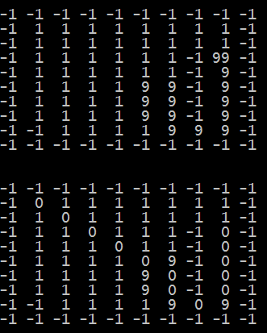
The results demonstrate the agent’s desire to maximise the path reward over minimising the path length.
Grid World containing the rewards
start
Grid World with the agent’s path
goal
0 – indicates the agent’s path

Slide 69
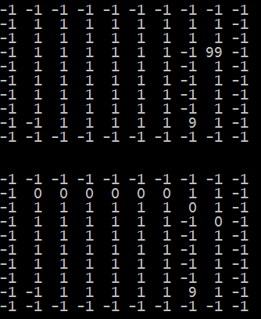
In this example, the agent receives only nominal rewards along the way (value of 1) but still learns the optimal path from the start to the goal state.
Grid World containing the rewards
start
Grid World with the agent’s path
goal
0 – indicates the agent’s path

Slide 70
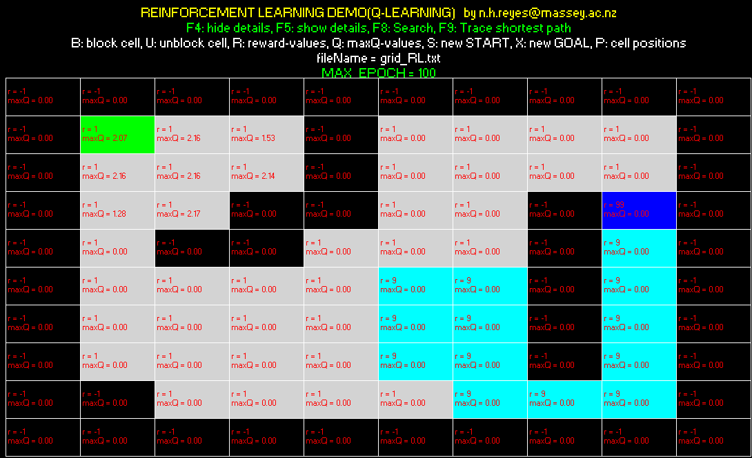
Behaviour of the system after training it for 100 epochs.
Not enough training epochs. No path was found, as the maxQ-values for some of the cells, to reach the Goal, is still zero.

Slide 71

Behaviour of the system after training it for 100,000 epochs.
A path is found!

Slide 72
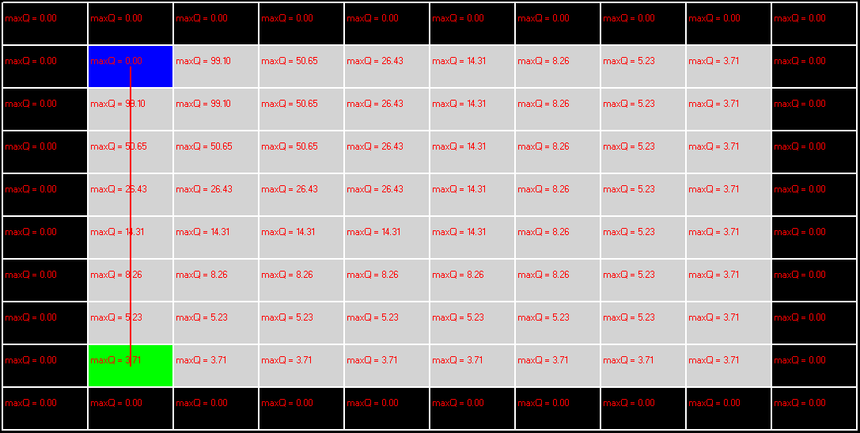
Behaviour of the system after training it for 100,000 epochs.
A path is found!

Slide 73
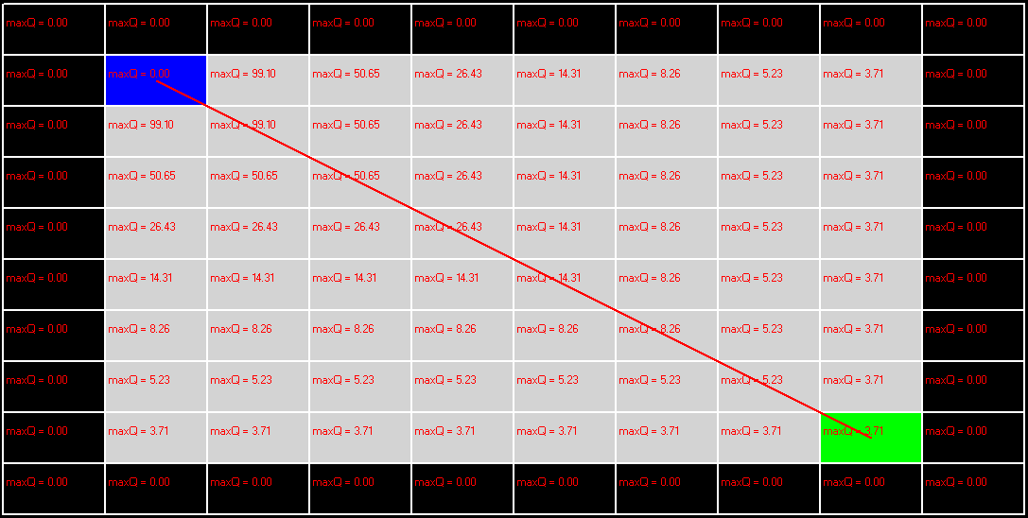
Behaviour of the system after training it for 100,000 epochs.

Slide 74
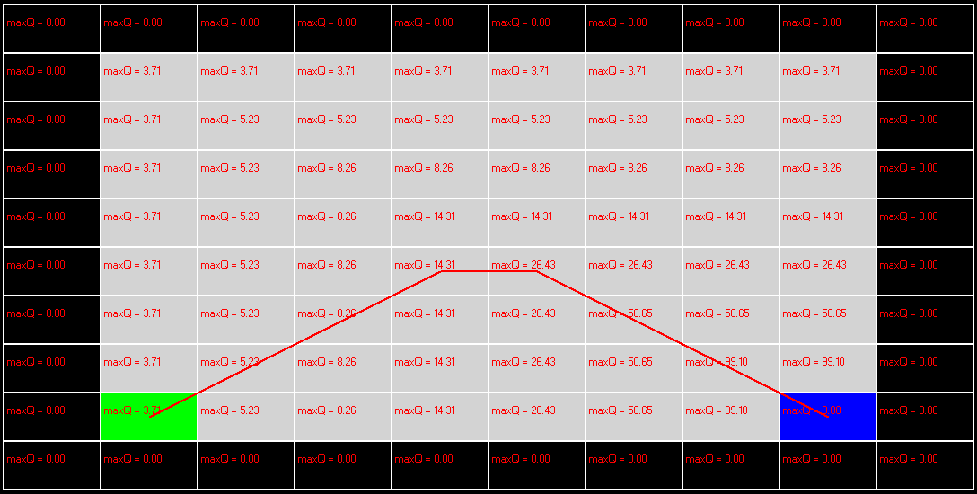
Behaviour of the system after training it for 100,000 epochs.
The path found is not a straight line!

Slide 75
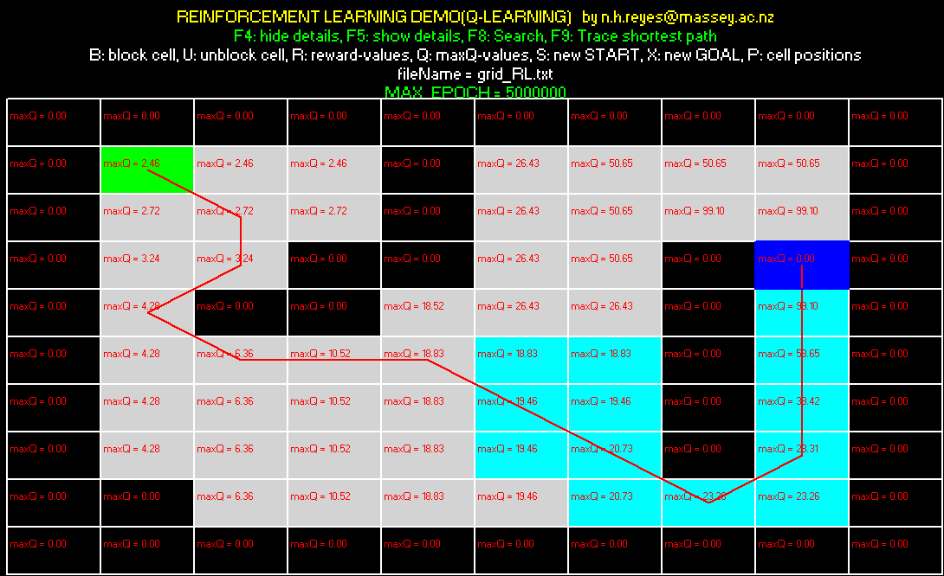
Behaviour of the system after training it for 5,000,000 epochs.
A path is found! The maxQ-values did not change anymore, as compared to training the system up to 100,000 epochs.

Slide 76
Modifications:
The Q-Learning example lifted from the book (Reference #1) is not able to find the optimal path to the goal as it is not taking into account the direct link cost of a horizontal, vertical or diagonal neighbour.
We can modify the updateFunction() to include direct link costs of neighbours when considering the different actions available. This modification will be made inside the Q-value update.
Note that the action selection scheme favours actions with high Q-values; therefore, we need to use the reciprocal of the actual the link costs.

Slide 77
Updating the Q-Value (modified version)
void updateFunction( int y, int x, int action ){
int newy = y + dir[action].y;
int newx = x + dir[action].x;
double reward;
reward = (double)grid[newy][newx] + 0.1; //reward for entering next state
findMaxQ( newy, newx );
double linkCost=0.0;
if(action % 2 == 0){
linkCost = 1.0;
} else {
linkCost = 1.0/1.41;
}
stateSpace[y][x].Q[action] += LEARNING_RATE * (reward + (DISCOUNT_RATE * (stateSpace[newy][newx].maxQ + linkCost)) - stateSpace[y][x].Q[action]);
updateSum( y, x ); //calculate the sum of Q-values for the state
return;
}
Use the reciprocal as the algorithm favours actions with high Q-values

Slide 78
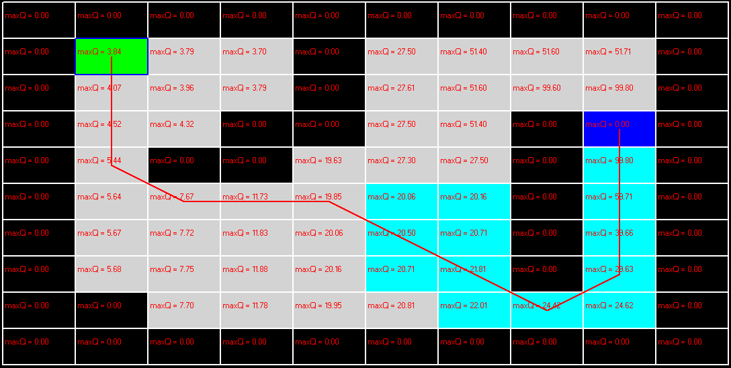
With link cost taken into account, as part of Q-value computations.
A better path is found!

Slide 79
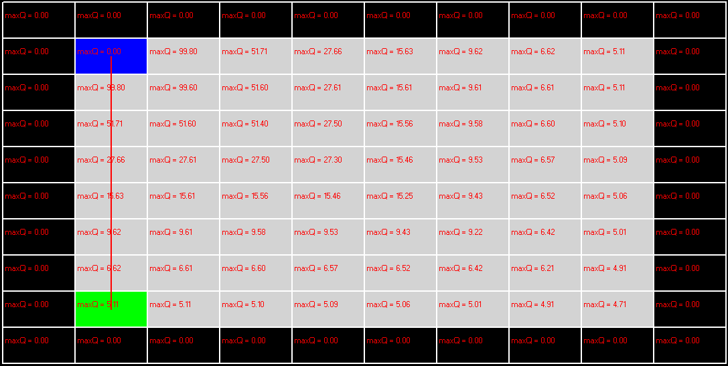
With link cost taken into account, as part of Q-value computations.

Slide 80
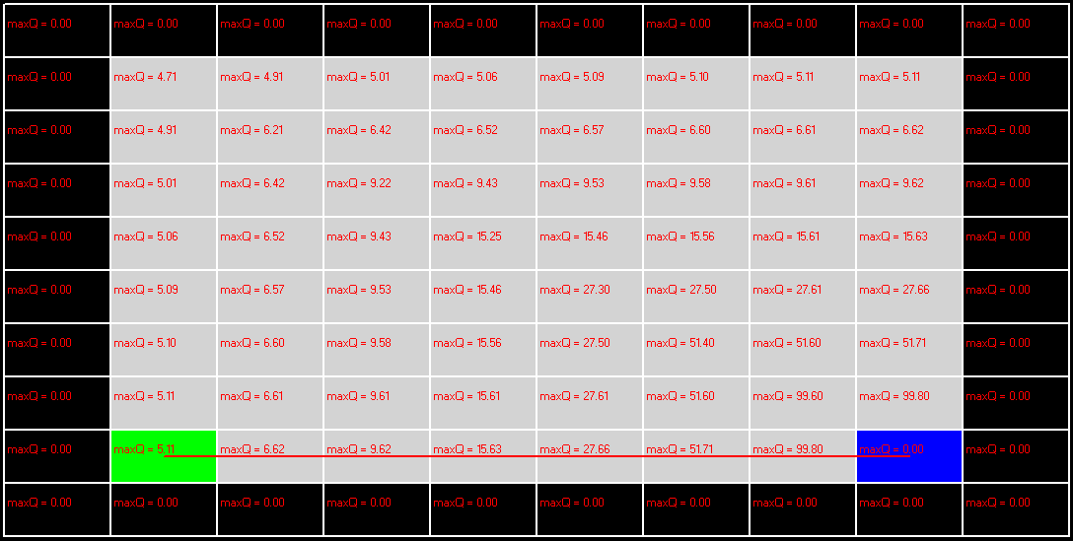
With link cost taken into account, as part of Q-value computations.
Problem solved! ☺

Slide 81

With link cost taken into account, as part of Q-value computations.
Problem solved! ☺

Slide 82
Let’s see some demo

Slide 83
Q-Learning
Exploration
Discovers state space
Takes risks, makes mistakes, learns
Random, biased
Exploitation
Uses known information to pick action
Learned policy
The algorithm uses exploration to learn.
To perform well, it uses exploitation.
Converges to an optimal policy when repeated sufficiently many times.

Slide 84
SARSA

Slide 85
SARSA
It was proposed by Rummery and Niranjan in a technical note[1] with the name "Modified Connectionist Q-Learning" (MCQ-L).
The alternative name SARSA, proposed by Rich Sutton, was only mentioned as a footnote.
Pseudo code from Sutton, 2018 book

Slide 86
SARSA vs. Q-Learning
Cliff Walking Problem, standard discounted episodic task, 4-connected grid
Figure from Sutton, 2018 book
Reward = -1 on all transitions except those into the region marked “The Cliff”.
Reward = -100, “The Cliff” region.
Stepping into the cliff sends the agent instantly back to the start.

Slide 87
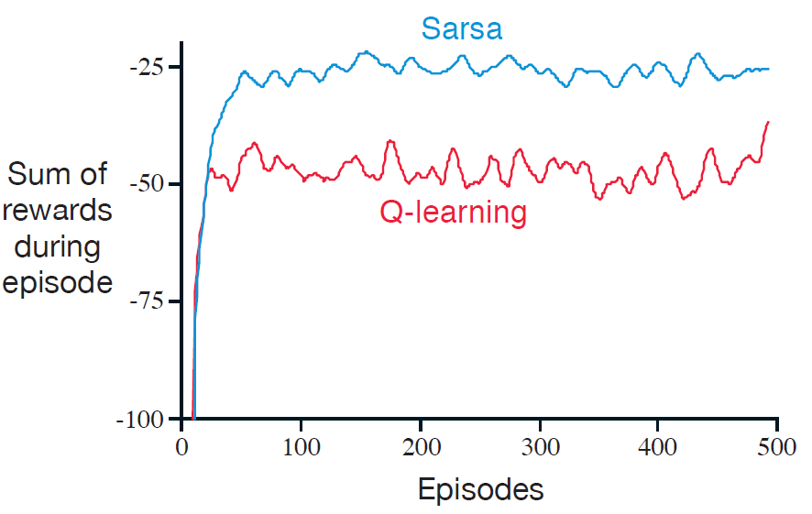
SARSA vs. Q-Learning
Performance of SARSA and Q-Learning with ε-greedy action selection, ε=0.1
Q-learning received more punishments (negative rewards) than SARSA, as it caused the agent to fall-off the cliff occasionally due to the e-greedy action selection scheme.
Nevertheless, Q-Learning was able to find the values for the optimal policy, that which travels right along the edge of the cliff.
Notes:
Q-learning received more punishments (negative rewards) than SARSA. However, it was able to find the values for the optimal policy, that which travels right along the edge of the cliff.

Slide 88
SARSA vs. Q-Learning
Performance of SARSA and Q-Learning with ε-greedy action selection, ε=0.1
SARSA learned the longer but safer path through the upper part of the grid, as it took into account the learned action selection.
SARSA has a better on-line performance than Q-Learning. SARSA learned the roundabout policy.
Notes:
Q-learning received more punishments (negative rewards) than SARSA. However, it was able to find the values for the optimal policy, that which travels right along the edge of the cliff.

Slide 89
SARSA vs. Q-Learning
If ε were gradually reduced, then both methods would asymptotically converge to the optimal policy.
Notes:
Q-learning received more punishments (negative rewards) than SARSA. However, it was able to find the values for the optimal policy, that which travels right along the edge of the cliff.

Slide 90
References
M. Tim Jones, AI Application Programming (2nd Edition, 2005)
Richard S. Sutton and Andrew G. Barto, Reinforcement Learning: An Introduction, Second edition, 2018
MIT opencourseware
http://web.eecs.umich.edu/~baveja/rldl.html

Slide 91
C:\CORE\Massey_Papers_2016\159740-2016\Website\159740\Demo_2016\QLEARNING_2016
main grid_RL.txt grid_RL_rewards.txt
main grid_RL2.txt grid_RL2_rewards.txt
main grid_RL0.txt grid_RL0_rewards.txt
main grid_RL01.txt grid_RL01_rewards.txt

